Slide 1
UTEM HEALTHCARE INFORMATICS
PhysioSystem: Tele-Rehabilitation & Clinical Prescriptions Platform
Full-stack tele-rehabilitation closing the home adherence gap with dynamic protocol planning and recovery intelligence.
INSTITUTION
ENGINEERING MODEL
SYSTEM STATUS
Universiti Teknikal Malaysia Melaka
6-Module Feature-Isolated Branching
Complete • 0 Build Errors

Slide 2

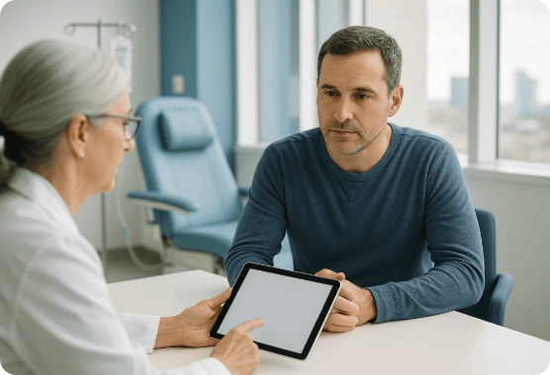
EXECUTIVE PROBLEM STATEMENT
Bridging the Post-Operative Adherence Chasm
The Current Clinical Bottleneck
70% of physical therapy outpatients drop adherence due to static paper sheets and lack of execution feedback.
The PhysioSystem Intervention
Unified digital tele-rehab connecting orthopedic surgeons, physiotherapists, nurses, and homebound patients.

Slide 3
VALIDATED EFFICIENCY GAINS
Quantifiable Clinical Performance
<45s
85%
225kB
Prescription Creation
Projected Compliance
Optimized Bundle
Reduced down from 7.5 minutes manual drafting.
Substantial leap from traditional 30% baseline.
Zero-error production build across 6 feature modules.

Slide 4
SYSTEM ARCHITECTURE
High-Concurrency Clinical Engineering Stack
Frontend Engine
Backend Core
Persistence Layer
React 18 & TypeScript
Rust (Axum 0.7 + SQLx)
SQLite relational schema
Vite build pipeline
Node.js bridge runtime
ACID atomic transactions
Zero type errors in build
High-throughput concurrency
Cascading integrity keys

Slide 5
CLINICAL ONBOARDING & PRESCRIPTIONS
Intake Profiling & Prescription Planner
MODULE 01
MODULE 02
Auth & Intake Profiling
Doctor Prescription Planner
Multi-role RBAC access for doctors, nurses, patients
1-Click templates for ACL, Rotator Cuff, Lumbar
Injury classification & joint angle ROM baselines
Dynamic workout duration calculation formula
Seamless clinical profile initiation
Hospital take-home print matrix with letterhead

Slide 6

MODULE 2 MATHEMATICAL PRECISION
Workout Duration & Over-Fatigue Protection
Real-Time Calculation
Fatigue Prevention
Instant daily session duration feedback as doctors configure regimens.
Prevents excessive joint loading during early stage post-operative care.

Slide 7

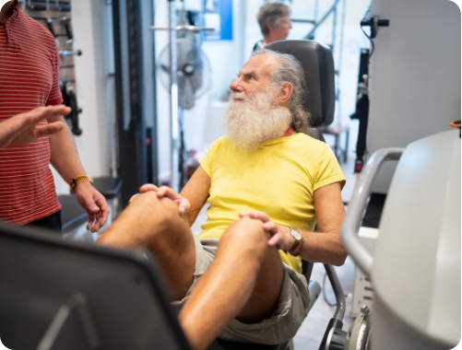
PATIENT GUIDANCE & ENGAGEMENT
Movement Guidance & Gamified Engine
Module 3: Kinematic Video Library
Joint-categorized video library demonstrating tempo, ROM angles, and safety contraindications.
Module 4: 60 FPS Rehab Engine
HTML5 Canvas rendering isometric hold rings, repetition streaks, and adherence milestones.

Slide 8
MODULE 05: CLINICAL TRIAGE
Nurse Observations & Activity Logging
Target vs Actual
VAS Pain Slider
Borg RPE Scale
Urgent Red Flags
Logs completed sets against prescribed regimens.
Standardized 0-10 visual analog tracking scale.
Assesses perceived exertion during home session.
Instant triage for swelling, redness, or pain spikes.

Slide 9
MODULE 06: CLINICAL ANALYTICS
Longitudinal Recovery Trajectory
Knee Flexion Range of Motion (Degrees)
Benchmark: 135° Full Recovery
Week 1 (Intake Baseline)
45°
Week 3 (Early Mobilization)
75°
Week 6 (Strengthening Phase)
110°
Week 8 (Target Milestone)
130°

Slide 10
COLLABORATION ENGINEERING
Branch-Isolated Feature Architecture
BRANCH | MODULE SCOPE | PRIMARY DELIVERABLE | STATUS
feat/mod1 | Auth & Onboarding | Multi-role RBAC & ROM intake | Merged
feat/mod2 | Prescription Planner | Duration engine & 7-day print matrix | Merged
feat/mod3 | Kinematic Guides | Curated joint library & warnings | Merged
feat/mod4 | Gamified Engine | Canvas isometric loop & streak multiplier | Merged
feat/mod5 | Nurse Activity Logger | VAS pain slider & Borg exertion scale | Merged
feat/mod6 | Recovery Analytics | ROM curves & surgeon red-flag alerts | Merged

Slide 11
PRODUCTION STATUS
Engineering Verification & Performance
Build & Performance Rigor
Clinical Impact Verification
Zero TypeScript compilation errors
Prescription drafting in under 45 seconds
Optimized 225 kB production bundle
Home adherence uplift projected to 85%
Rust Axum sub-millisecond query routing
Automated alert triage for high pain scores

Slide 12
PHYSIOSYSTEM PLATFORM
Ready for Clinical Evaluation
Transforming outpatient rehabilitation with high-reliability software engineering and objective recovery telemetry.
Questions & Discussion • UTeM Graduate Program in Software Engineering

Slide 13


Image Sources
https://acibademinternational.com/wp-content/uploads/2026/09/targeted-therapy-12587-AdgcJm-1024x683.webp
Source: acibademinternational.com
https://regenerativejointclinics.com/wp-content/uploads/patellar-tendinitis-physical-therapy-riverdale-ga.jpg
Source: regenerativejointclinics.com

